Slide 1

Circular Pie - Github
Team 5
Yash Kantharia
Alan Parmar
Poonam Adtani
Maneesha Narahari
Saichand Reddy
Tharun Reddy
Sarvesh Desai

Slide 2
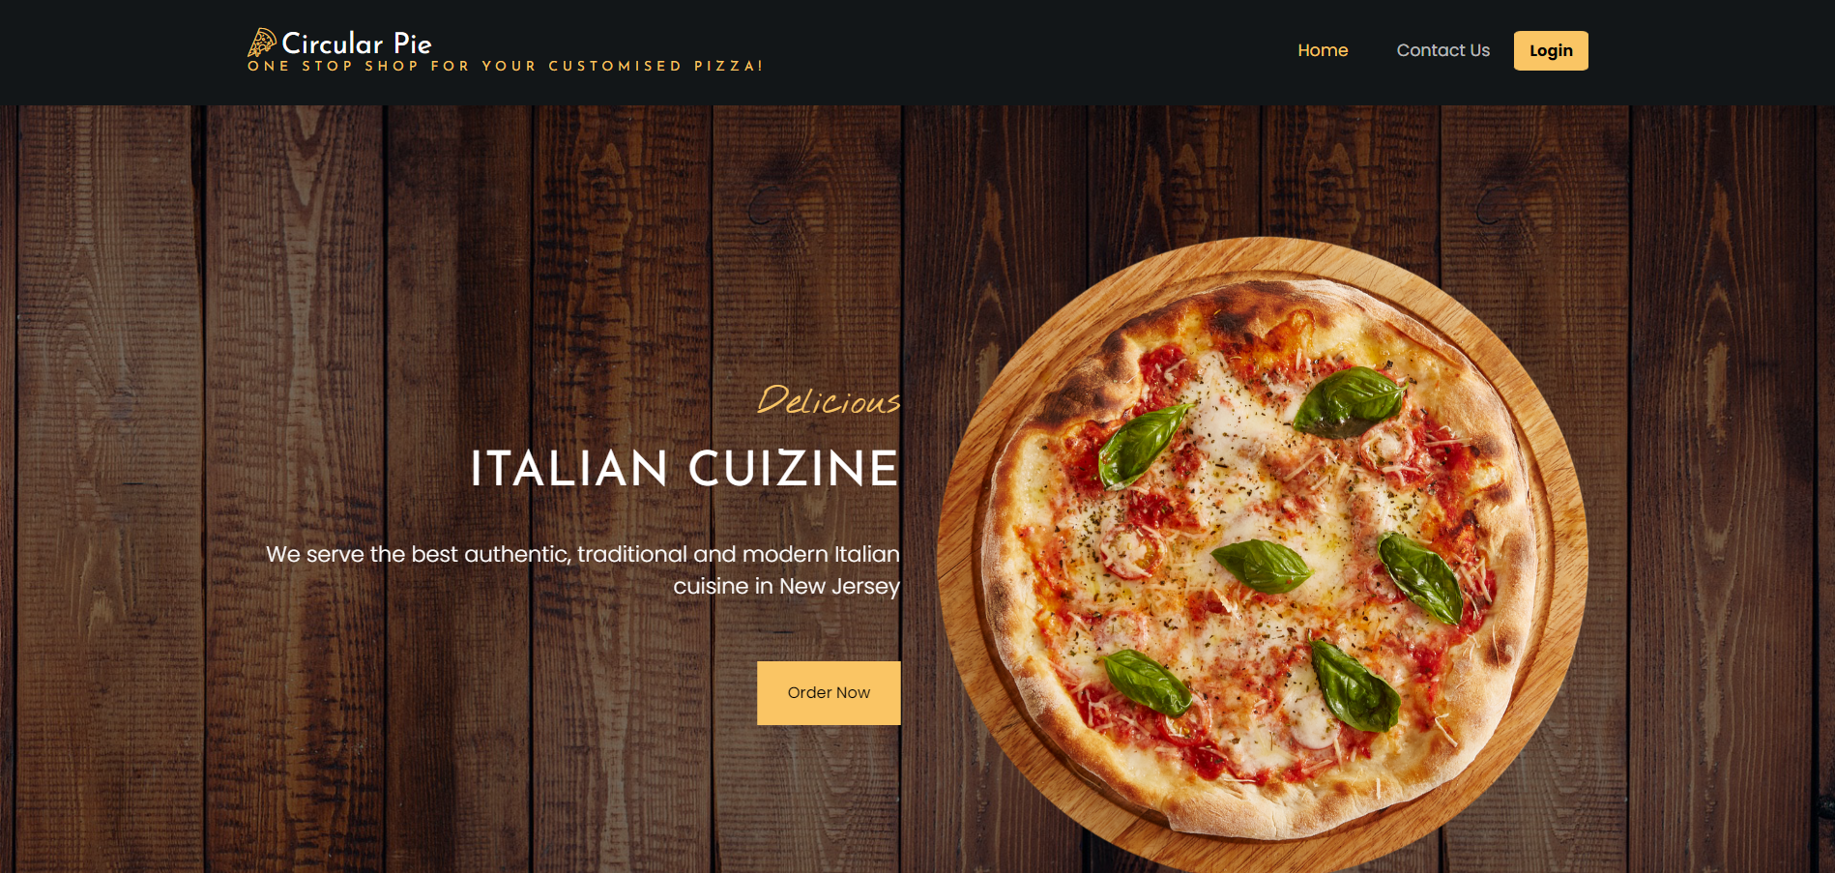
Github URL:
https://github.com/yashkantharia/Circular_Pie/tree/main/CircularPie

Slide 3
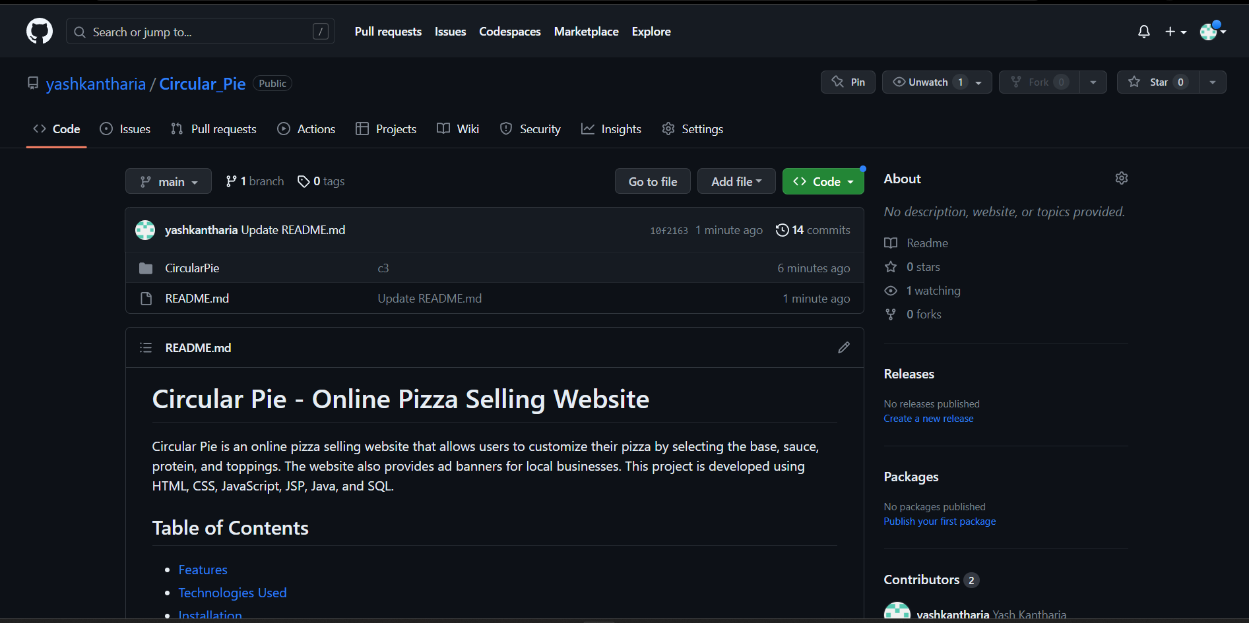
Repository Structure

Slide 4
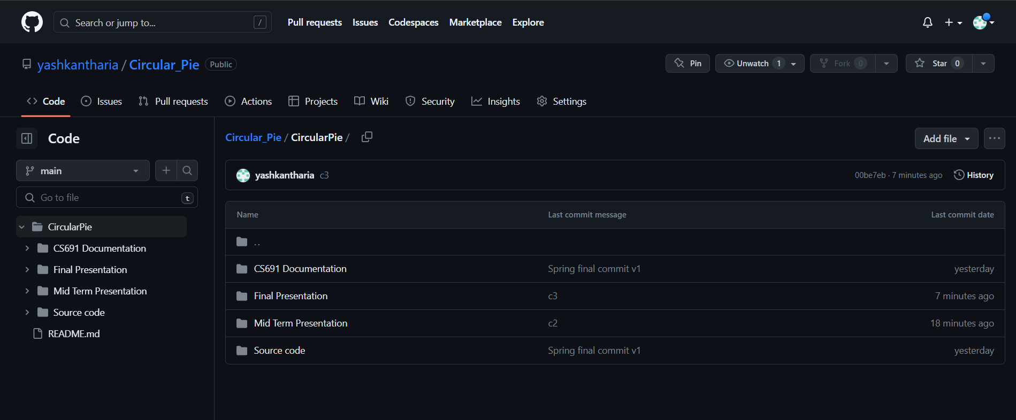
Repository Structure

Slide 5
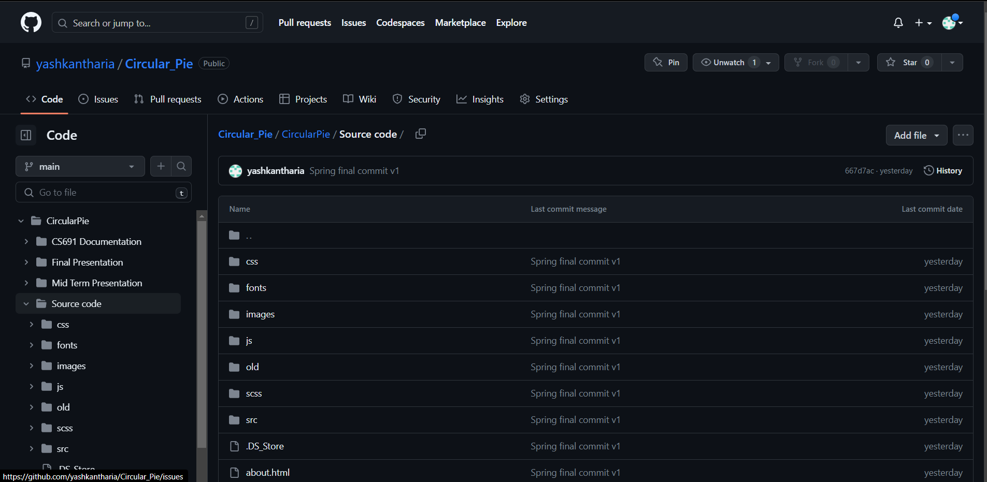
Repository Structure

Slide 6
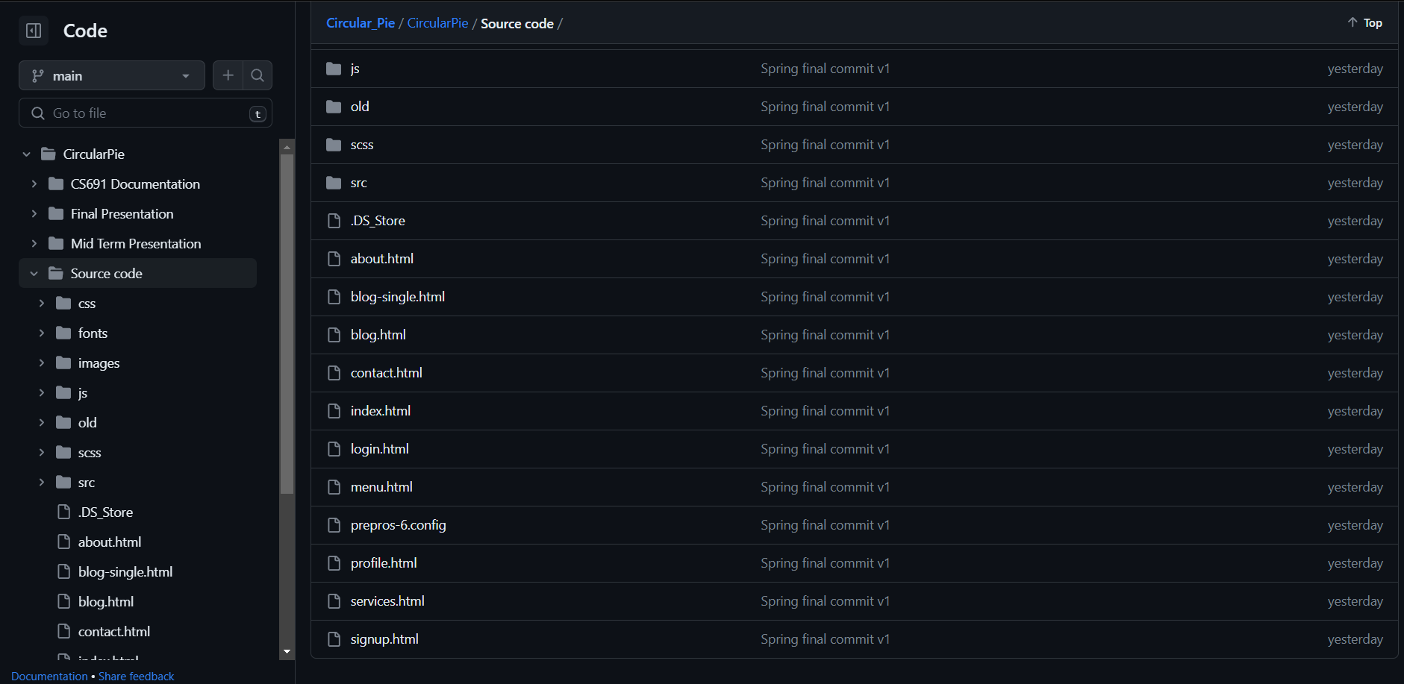
Repository Structure

Slide 7
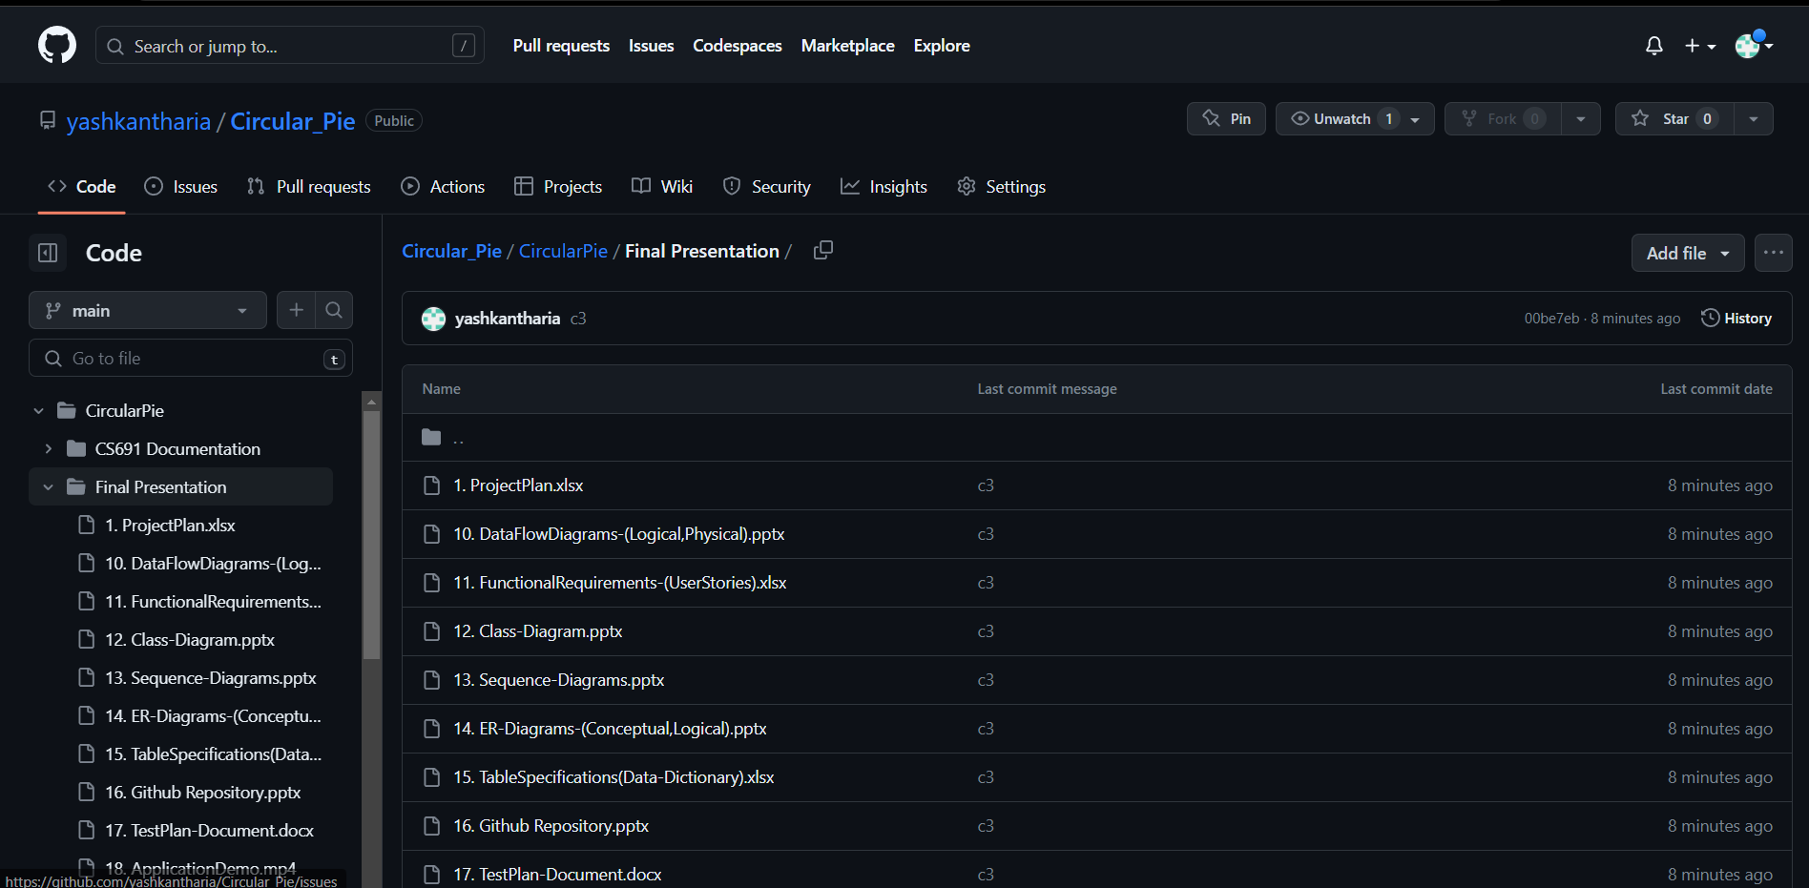
Repository Structure

Slide 8
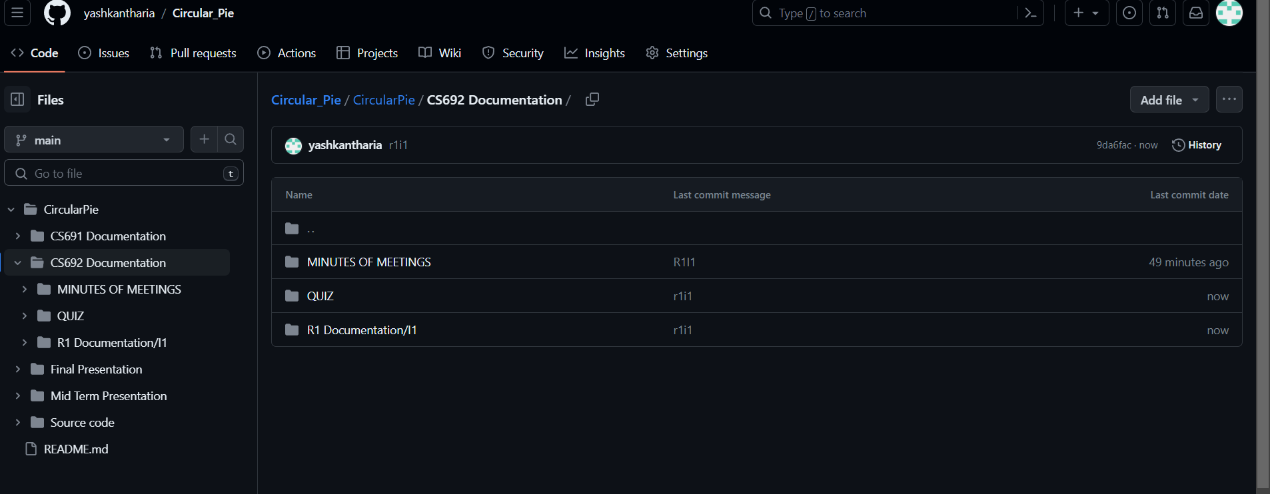
Repository Structure

Slide 9
Build and Deployment Procedures
Prerequisites
Sublime Text Build 4143
Java Eclipse Version: 2023-03 (4.27.0)
Oracle Database 21c Express Edition Release 21.0.0.0.0 – Production Version 21.3.0.0.0
JDK 1.8.0
Github Desktop Version 3.2.1 (x64)
Tomcat Server v9.0

Slide 10
Build and Deployment Procedures
Installation
Clone this repository.
git clone https://github.com/your-username/circular-pie.git
Install the prerequisite software mentioned earlier.
Open the repository in Eclipse
Start the Tomcat server from Eclipse.
Start the SQL server using SQL Plus

Slide 11
Feature Implemented
Account Management Module
Create Account
Login Account
Modify Account*
Delete Account*
Contact Us*

Slide 12
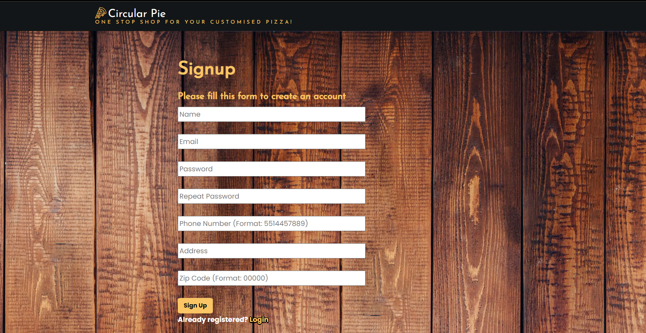
Feature Implemented - Signup

Slide 13
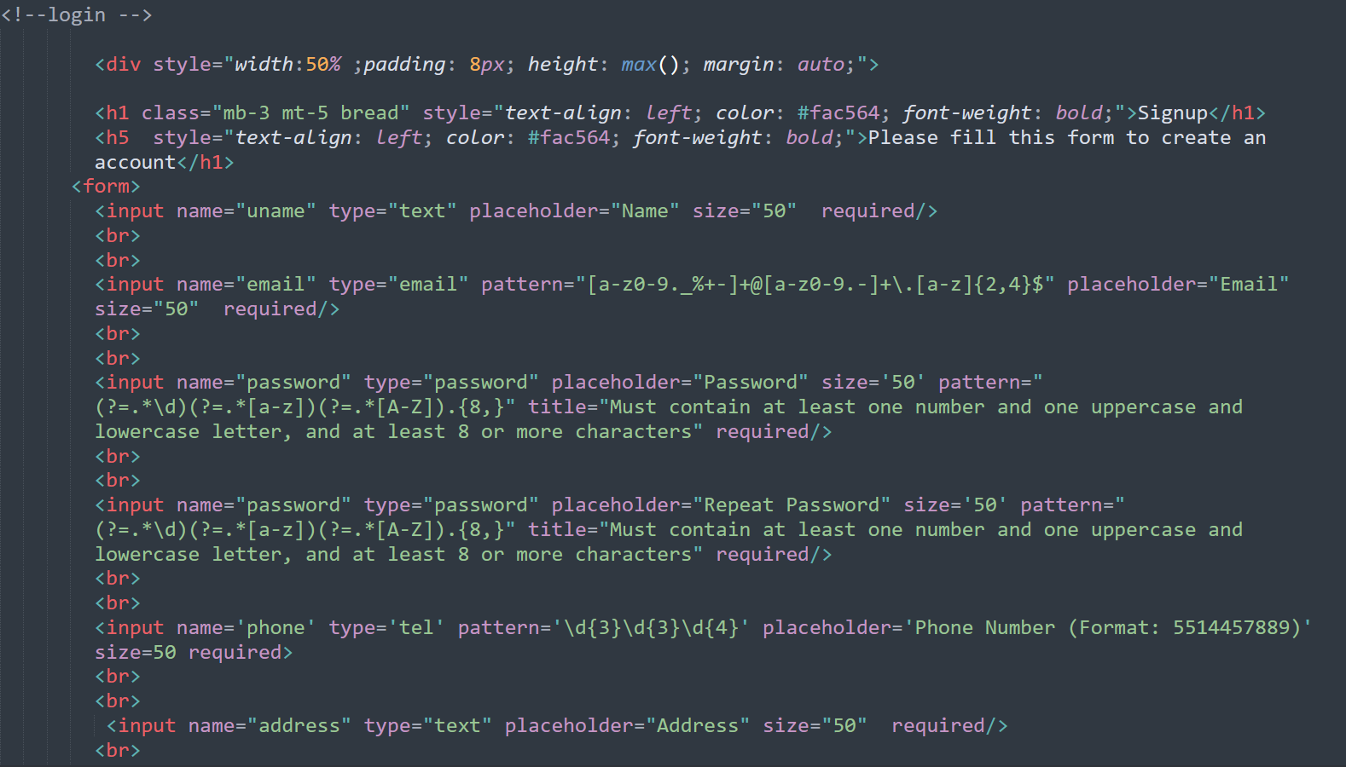
Feature Implemented - Signup

Slide 14
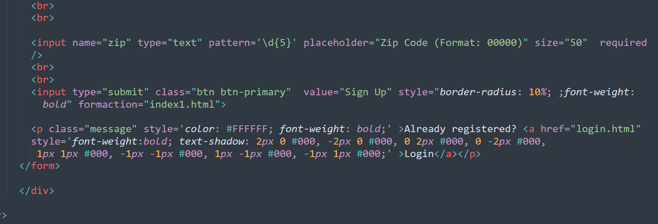
Feature Implemented - Signup

Slide 15
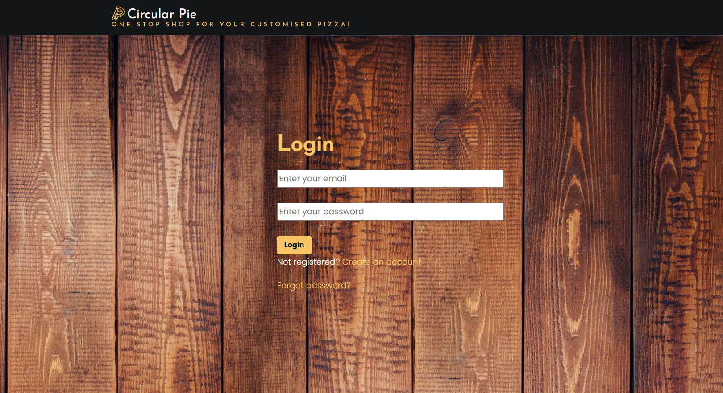
Feature Implemented - Login

Slide 16
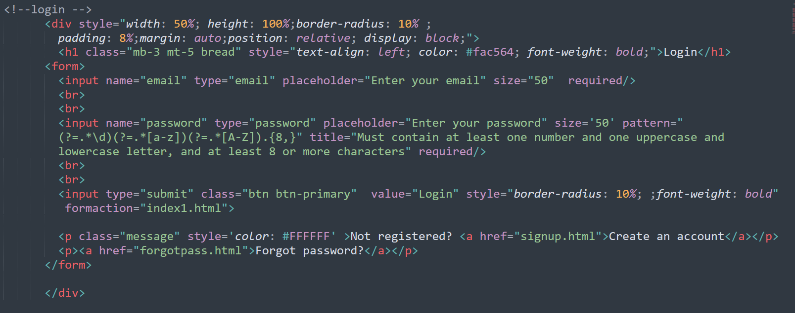
Feature Implemented - Login

Slide 17
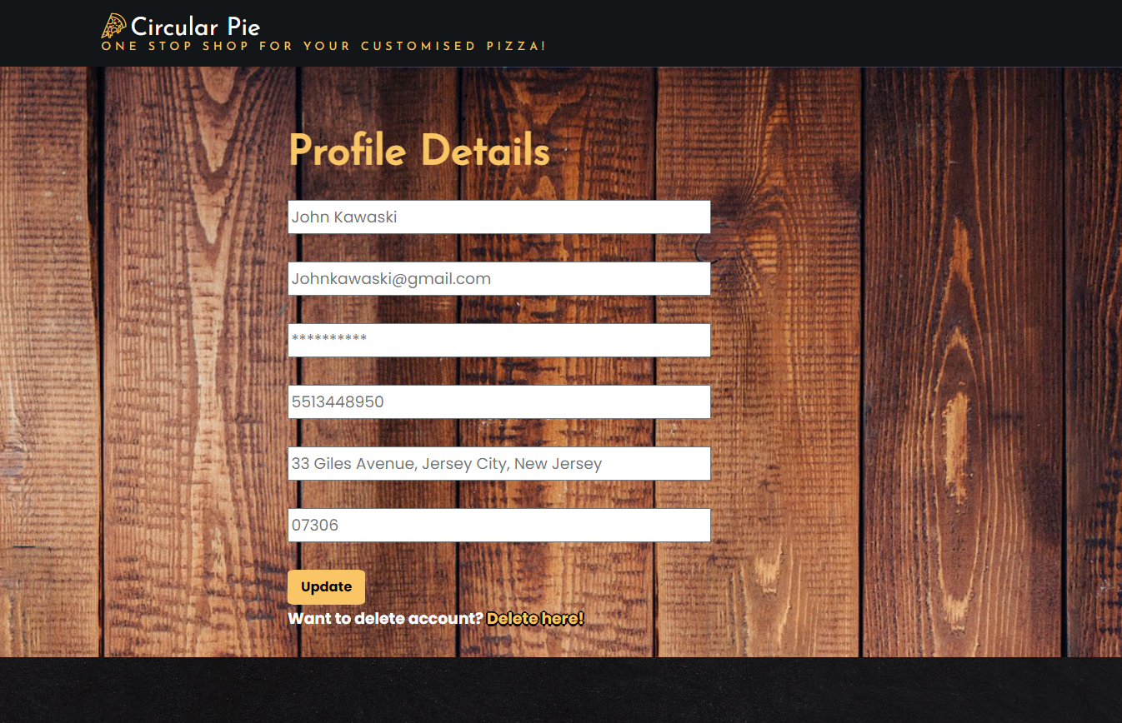
Feature Implemented – Modify/Delete Account

Slide 18
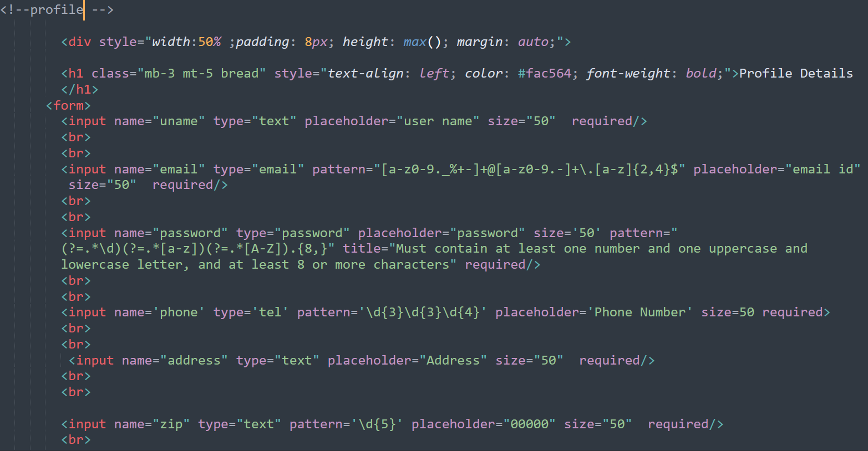
Feature Implemented – Modify/Delete Account

Slide 19
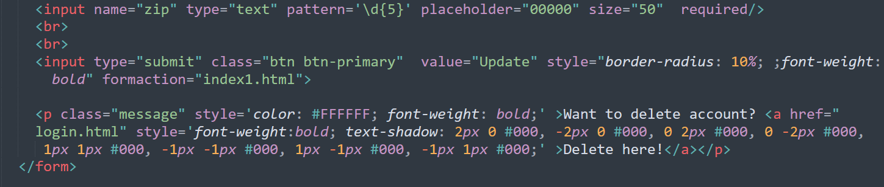
Feature Implemented – Modify/Delete Account

Slide 20
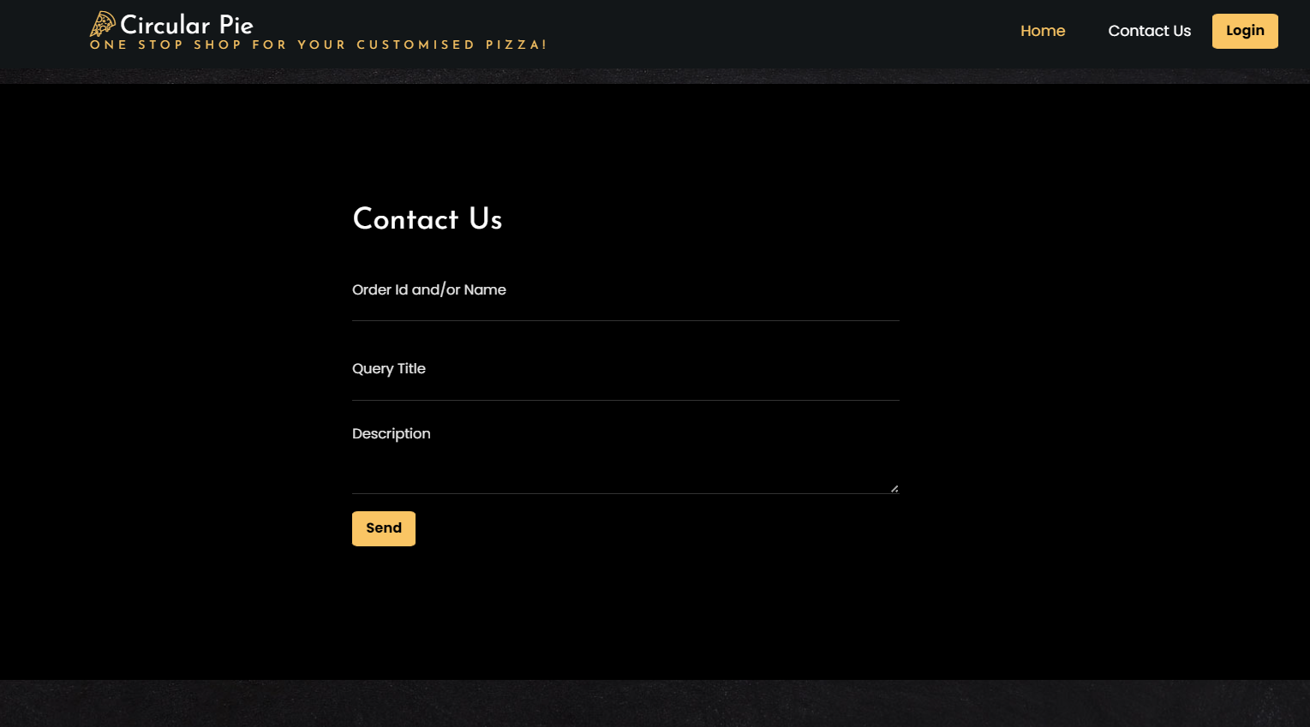
Feature Implemented – Contact Us

Slide 21
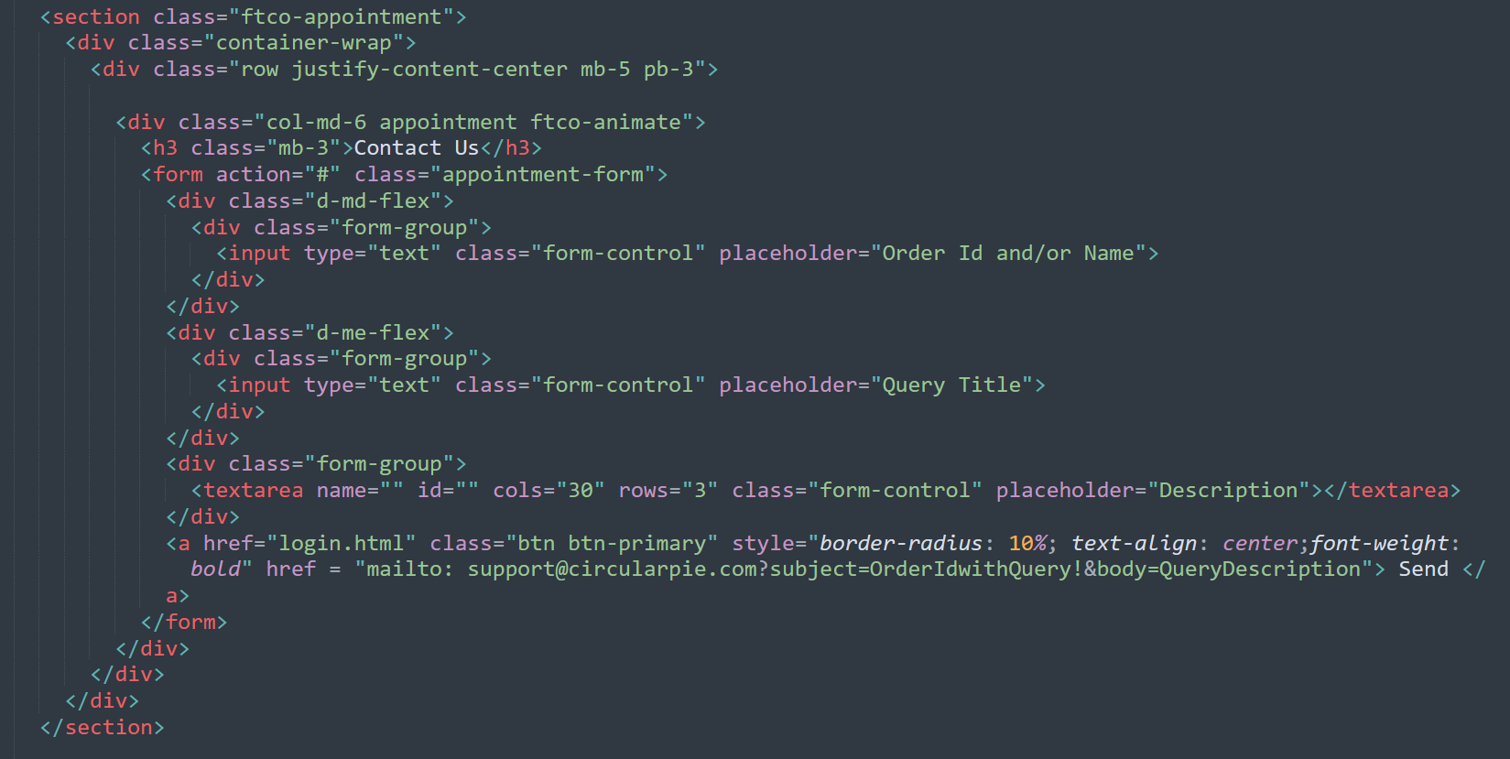
Feature Implemented – Contact Us

Slide 22
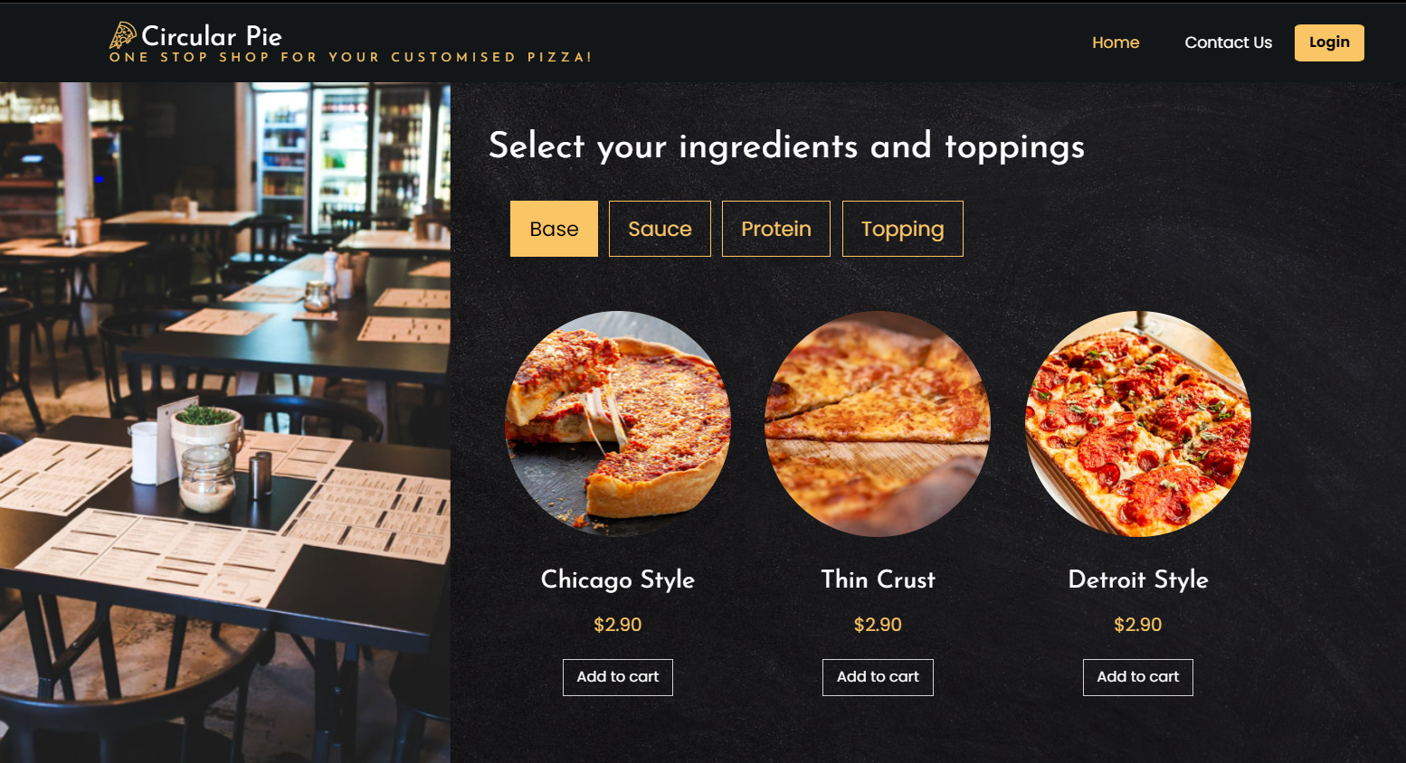
Feature Implemented – Customise Pizza

Slide 23
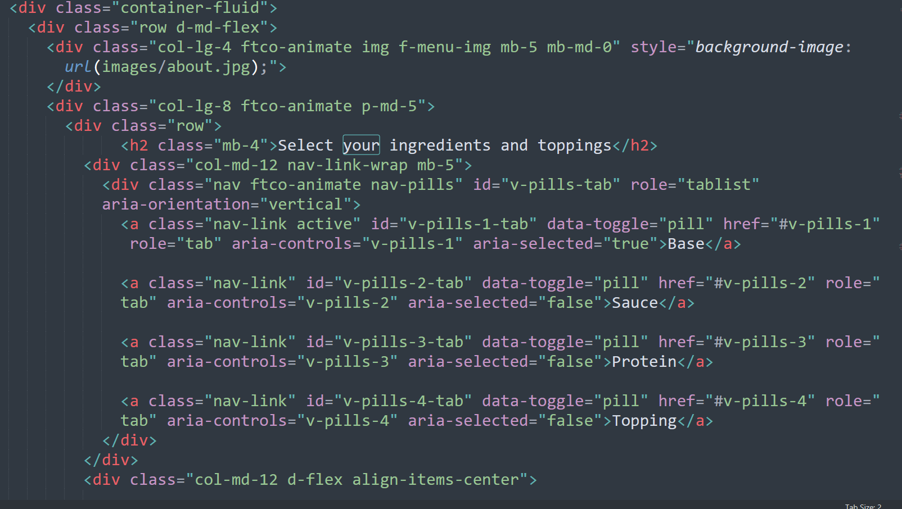
Feature Implemented – Customise Pizza

Slide 24
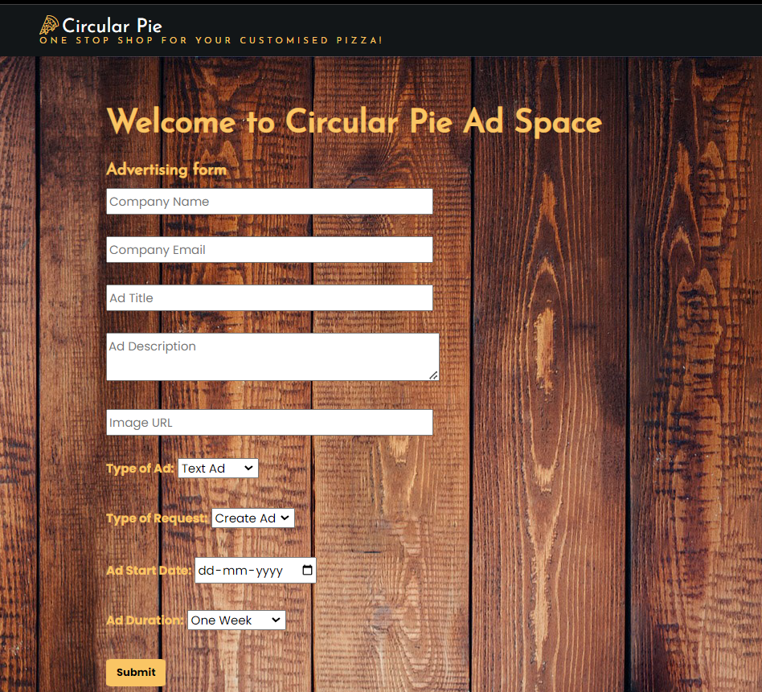
Feature Implemented – Create Ads

Slide 25
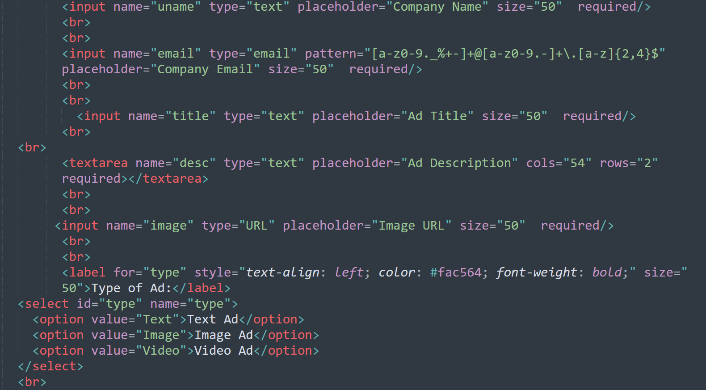
Feature Implemented – Create Ads

Slide 26
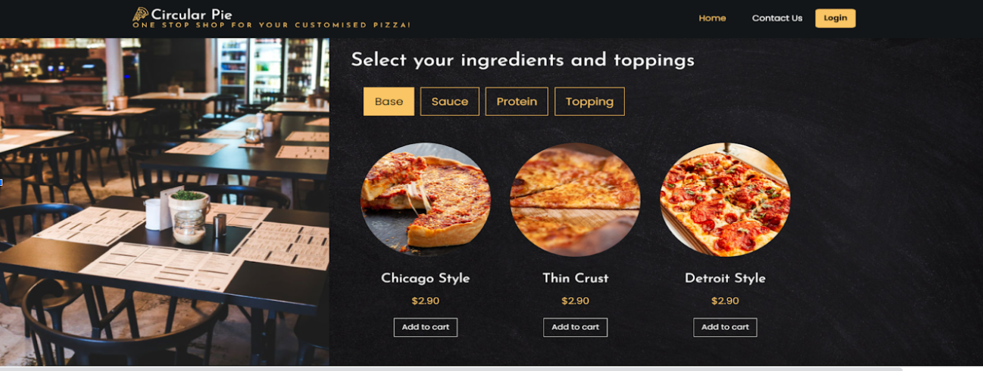
Feature Implemented – Add To Cart

Slide 27
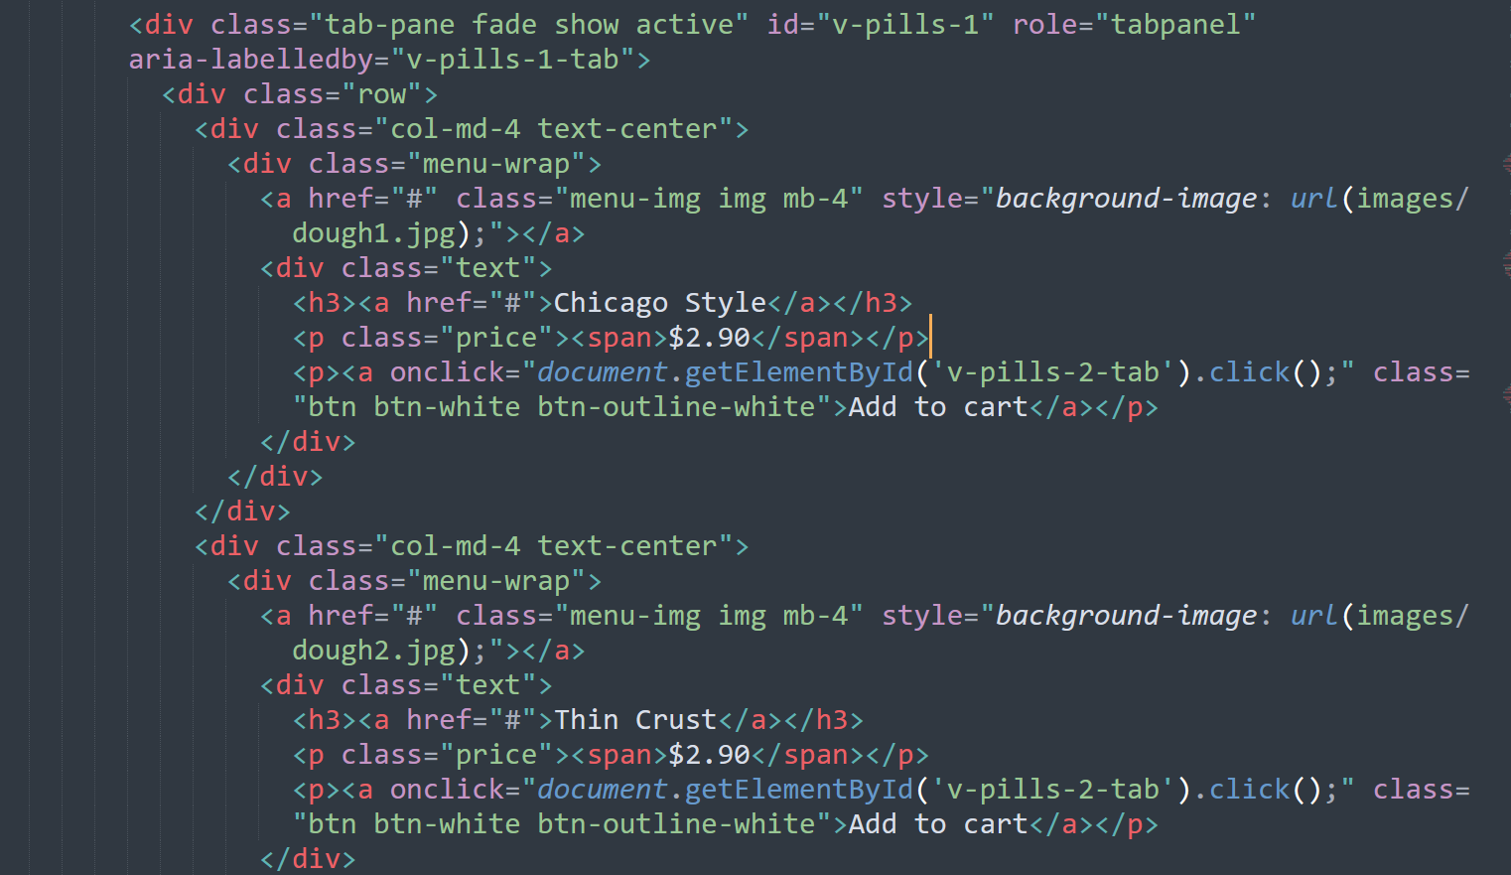
Feature Implemented – Add To Cart

Slide 28
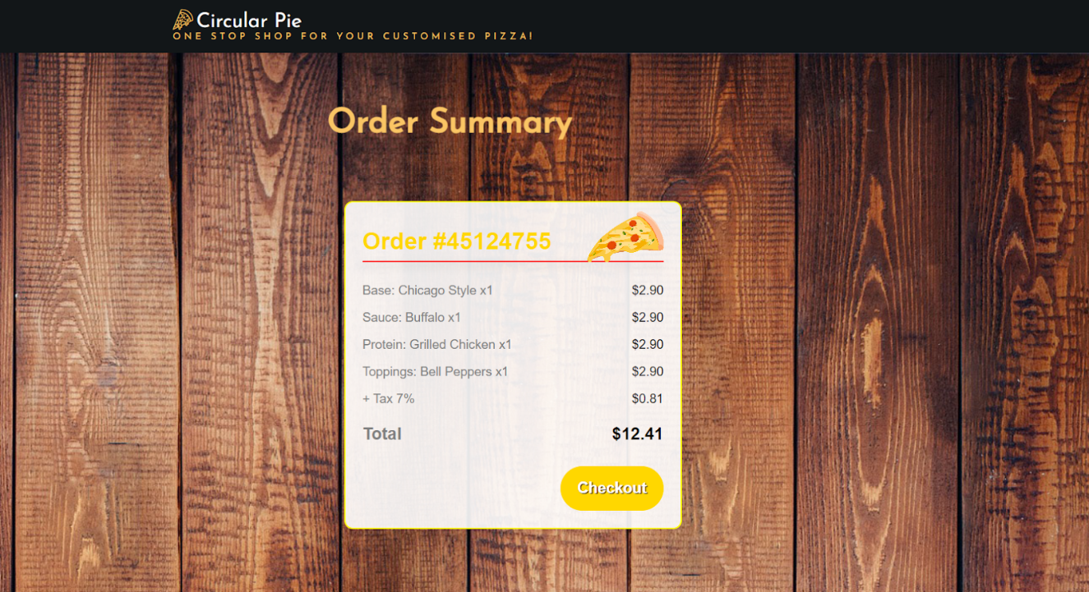
Feature Implemented – View Cart

Slide 29
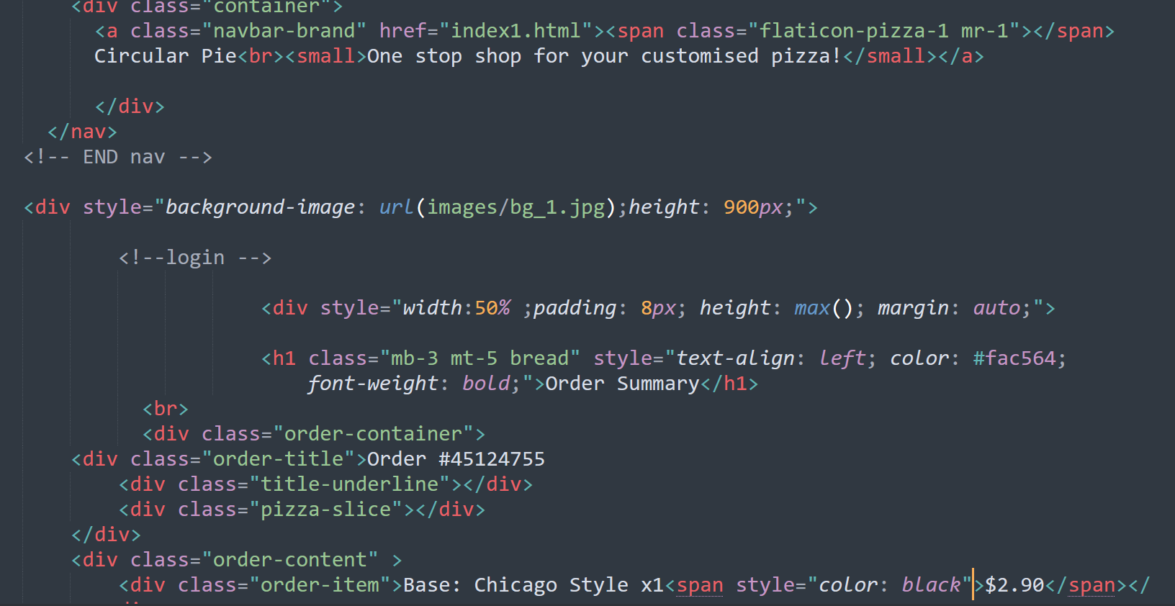
Feature Implemented – View Cart

Slide 30
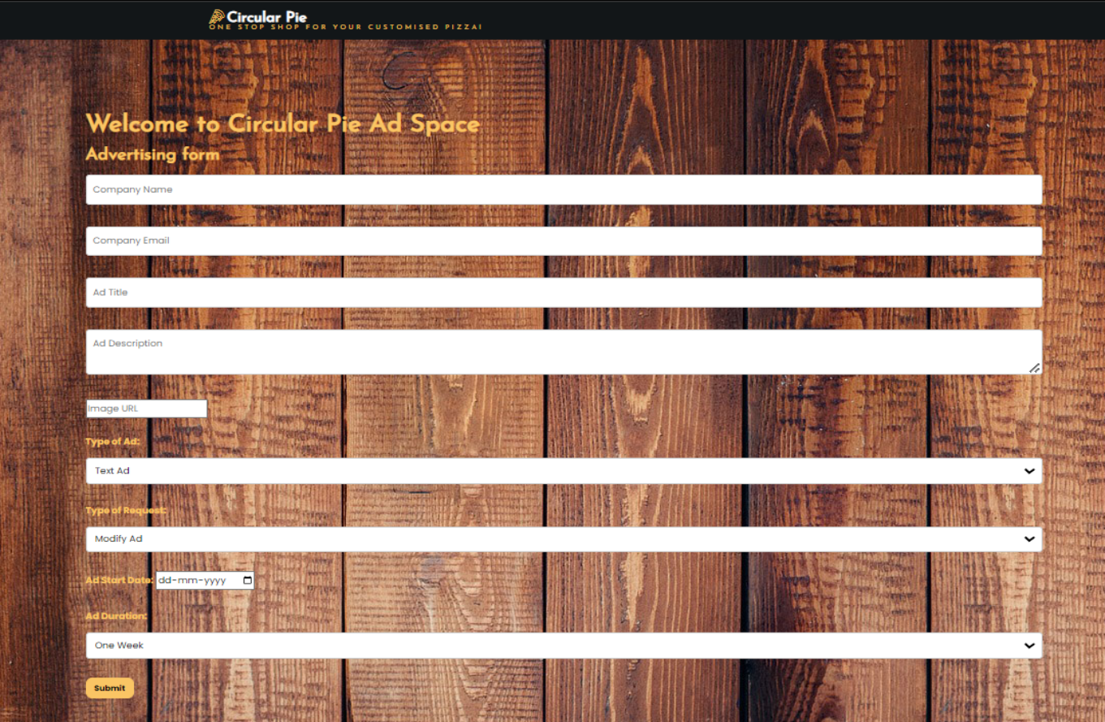
Feature Implemented – Modify Ad

Slide 31
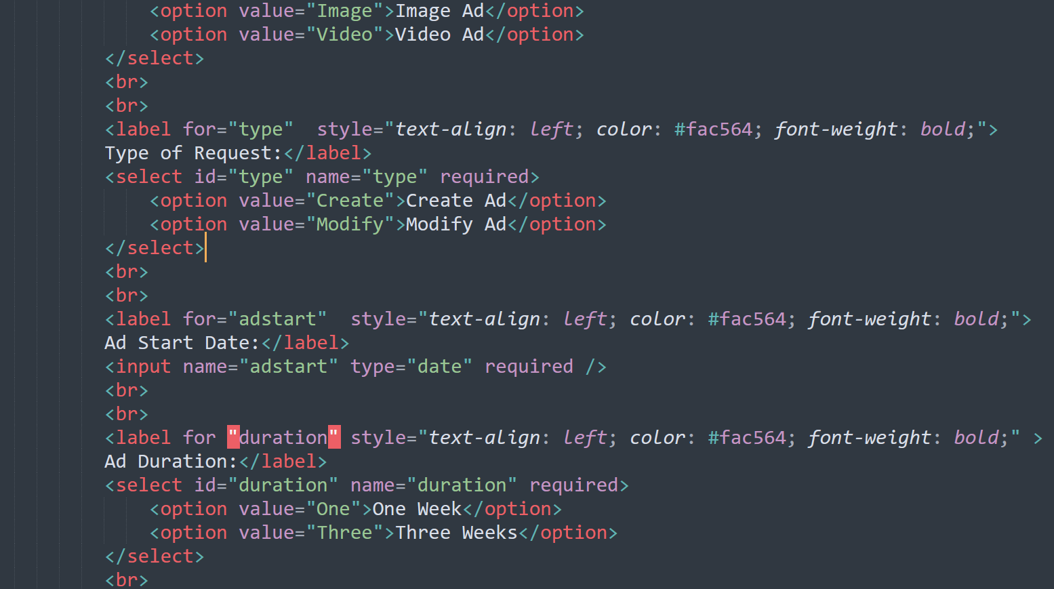
Feature Implemented – Modify Ad

Slide 32
Thank You!

